Slide 1

Machine Learning-2
Presented By- Chandrashekhar
cnsnoida@gmail.com
#9560333719

Slide 2
loc
Label-based / Index-based indexing using .loc
data.loc[['chandra', 'kumar'], 'city':'email']

Slide 3
iloc
iloc Pandas Dataframe is used for integer-location based indexing selection by position.
Data:
Country,Age,Salary,Purchased
France,44,72000,No
Spain,27,48000,Yes
Germany,30,54000,No
Spain,38,61000,No
data = pd.read_csv('/home/hadoop/hadoop/hadoop_working/DataScience/5.MachineLearningA-ZTemplate_data/Part1-DataPreprocessing/Data.csv')
## Rows:
data.iloc[0] # first row of data frame
data.iloc[1] #vertical
data.iloc[:1] #horizontal
data.iloc[:-1] #till last row of data fram
# Columns:
data.iloc[:,0] # first column of data frame
data.iloc[:,1] # second column of data frame
data.iloc[:,-1] # till last column of data frame

Slide 4
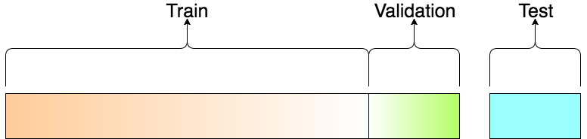
Test DataSet
The sample of data used to provide an unbiased evaluation of a final model fit on the training dataset.
# Splitting the dataset into the Training set and Test set
from sklearn.cross_validation import train_test_split
X_train, X_test, y_train, y_test = train_test_split(X, y, test_size = 0.2, random_state = 0)

Slide 5
Validation Dataset
The validation set is used to evaluate a given model, but this is for frequent evaluation.
Use this data to fine-tune the model hyper parameters.
split ratio:
Depends on 2 things.
1.The total number of samples in data
2.Actual model training.

Slide 6
Core topics
seed
hypothesis testing-
Error types
RoC curve
confusion matrix
trap
overfitting/underfitting
F1 score
L1 &L2 Regularization
PCA
confounding
LogLoss evaluation
Sigmoid Fn
Entropy
Elbow method
FF transform
Hidden markov

Slide 7
Seed
Predictive modeling project consider seeding for the random number generator.
Seed function is used to save the state of a random function, so that it can generate same random numbers on multiple executions of the code on the same machine or on different machines (for a specific seed value).
The seed value is the previous value number generated by the generator. For the first time when there is no previous value, it uses current system time.
Data Preparation. Data preparation may use randomness, such as a shuffle of the data or selection of values. Data preparation must be consistent so that the data is always prepared in the same way during fitting, evaluation, and when making predictions with the final model.
Data Splits. The splits of the data such as for a train/test split or k-fold cross-validation must be made consistently. This is to ensure that each algorithm is trained and evaluated in the same way on the same subsamples of dat
import random
for i in range(5):
# Any number can be used in place of '0'.
random.seed(0)
# Generated random number will be between 1 to 1000.
print(random.randint(1, 1000))

Slide 8
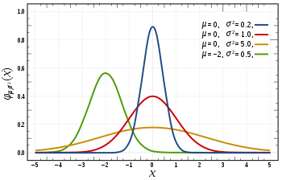
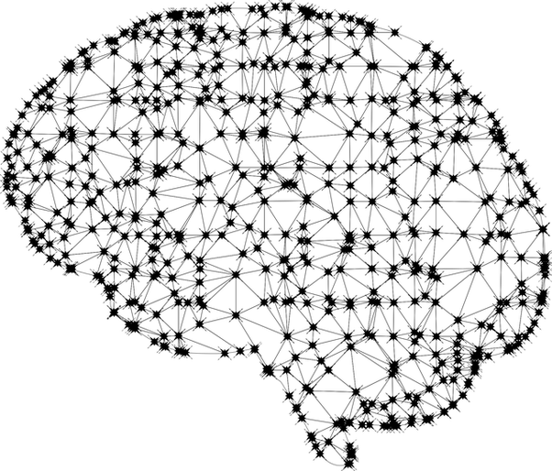
Hypothesis Testing in ML
Hypothesis testing is a statistical method that is used in making statistical decisions using experimental data. Hypothesis Testing is basically an assumption that we make about the population parameter.
Ex : Avg student in class is 40 or a boy is taller than girls..
The basic of hypothesis is normalisation and standard normalisation. all our hypothesis is revolve around basic of these 2 terms. Inferences are drawn for different ML models through T-test .
Null hypothesis: Assumption that there is no anomaly pattern or believing according to the assumption made.
Alternate hypothesis: Contrary to the null hypothesis, it shows that observation is the result of real effect.
P-value helps us to switch between these two hypotheses. There is some significant score of 5%. And if your P-value is lesser than this significant value then you choose to reject your null hypothesis and go along with alternate hypothesis.
Ex- Tossing coin

Slide 9
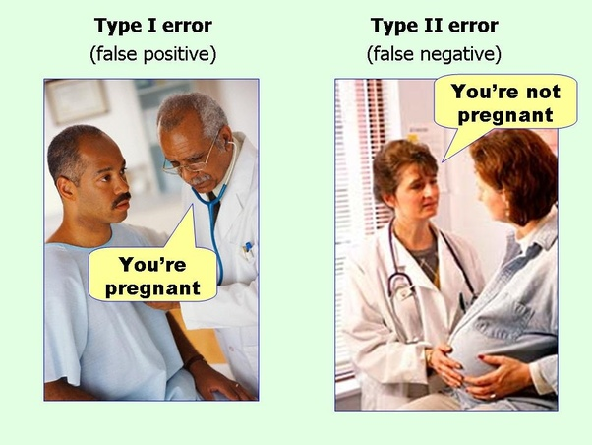
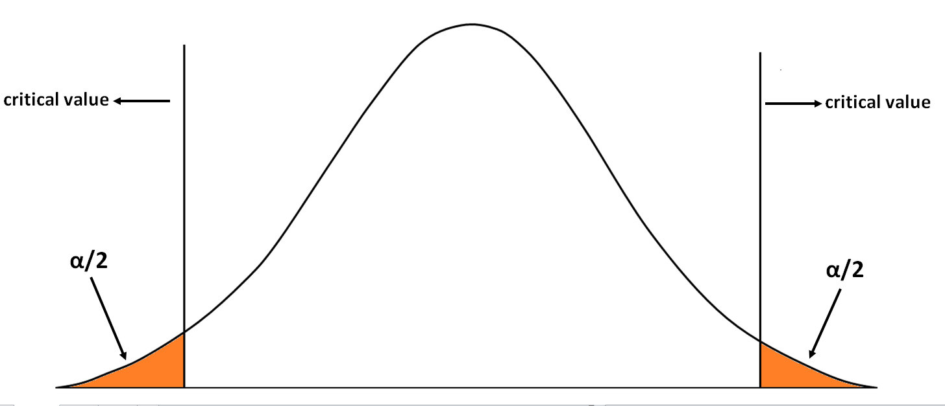
Error Types
As hypothesis testing is done on a sample of data rather than the entire population due to the unavailability of the resources in terms of data.
Due to inferences are drawn on sample data the hypothesis testing can lead to errors, which can be classified into two parts:
Type I Error: we reject the null hypothesis when it is true.False Positive
Type II Error: we accept the null hypothesis when it is false. False Negative
T-test-->>

Slide 10
ROC Curve
ROC curve is a graphical representation of the contrast between true positive rates and the false positive rate at various thresholds.
It’s often used as a proxy for the trade-off between the sensitivity of the model (true positives) vs the fall-out or the probability it will trigger a false alarm (false positives).

Slide 11
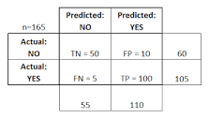
Confusion Matrix
from sklearn.metrics import confusion_matrix
A confusion matrix is a table that is often used to describe the performance of a classification model (or "classifier") on a set of test data for which the true values are known.
A confusion matrix is a technique for summarizing the performance of a classification algorithm.
Classification accuracy alone can be misleading if an unequal number of observations in each class or if more than two classes in dataset.
Calculating a confusion matrix can give a better idea of what classification model is getting right and what types of errors it is making.
classification accuracy = correct predictions / total predictions * 100

Slide 12
Dummy Variable(trap)
The Dummy Variable trap is a scenario in which the independent variables are multi columns - a scenario in which two or more variables are highly correlated
In simple terms one variable can be predicted from the others.

Slide 13
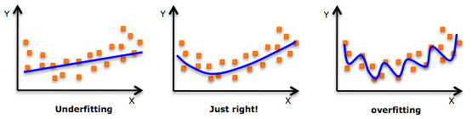
Overfitting/Underfitting
Split data into to subsets: (train, validate and test), and fit our model on the train data, in order to make predictions on the test data.
Over fitting happens when a model learns the detail and noise in the training data. it negatively impacts the performance of the model on new data.
Over fitting is more likely with non parametric and nonlinear models that have more flexibility when learning a target function

Slide 14
F1 Score
F1 score is a measure of a model’s performance.
It is Evaluation metric for classification algorithms
It is a weighted average of the precision and recall of a model, with results tending to 1 being the best, and those tending to 0 being the worst.
from sklearn.metrics import f1_score

Slide 15
L1 &L2 Regularization
L2 regularization tends to spread error among all the terms, while L1 is more binary/sparse, with many variables either being assigned a 1 or 0 in weighting.
  L1 regularization technique is called Lasso Regression .
  L1 corresponds to setting a Laplacean prior .
  L2 is called Ridge Regression.
  L2 corresponds to a Gaussian prior.
http://scikit-learn.org/stable/modules/linear_model.html

Slide 16
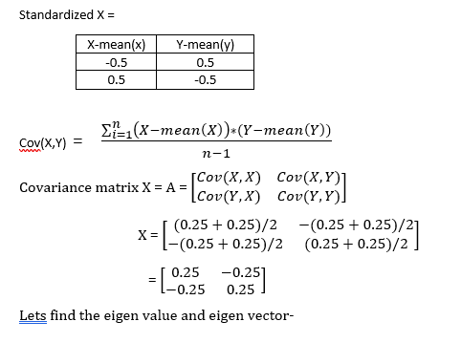

PCA
Principal components analysis-
To Reduce the feature
To handle missing values
PCA is finding the best projection of n-dimensional data points onto a smaller m-dimensional subspace*, where "best" means minimizing the total (squared) distance between your points and their smaller-dimensional projections.

Slide 17
Confounding
Confounding is a problem for prediction when the confounding relationship changes.
A confounding variable is something that is correlated with both independent and dependent variable.

Slide 18
LogLoss evaluation
Log loss is used when we have {0,1} response. This is usually because when we have {0,1} response, the best models give us values in terms of probabilities.
Log loss measures the UNCERTAINTY of the probabilities of model by comparing them to the true labels.
training labels are 0 and 1 but your training predictions are 0.4, 0.6, 0.89, 0.1122 etc.. So how do we calculate a measure of the error of our model ? If we directly classify all the observations having values > 0.5 into 1 then we are at a high risk of increasing the misclassification. This is because it may so happen that many values having probabilities 0.4, 0.45, 0.49 can have a true value of 1.

Slide 19
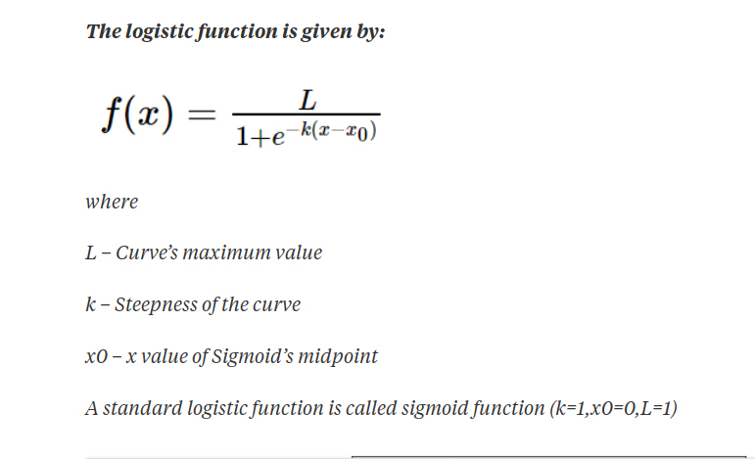
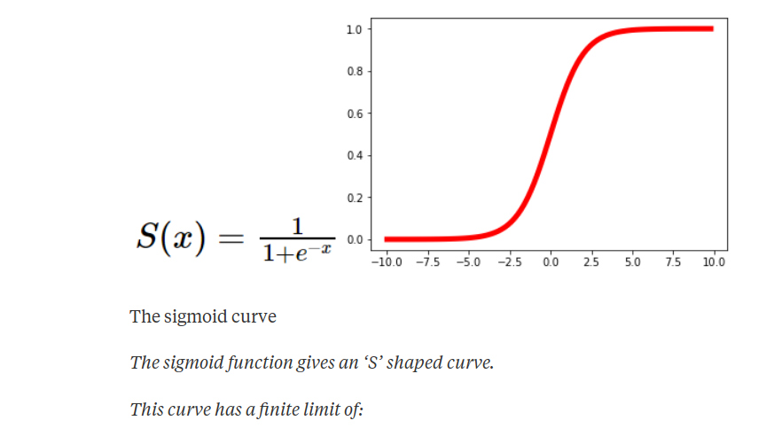
Sigmoid Fn
SIGMOID activation functions-
It is used in neural networks to give logistic neurons real-valued output that is a smooth and bounded function of their total input.
It also has the added benefit of having nice derivatives which make learning the weights of a neural network easier.
The Logistic Function: we would want to predict our outcomes as YES/NO (1/0).
A standard logistic function is called sigmoid function (k=1,x0=0,L=1)

Slide 20
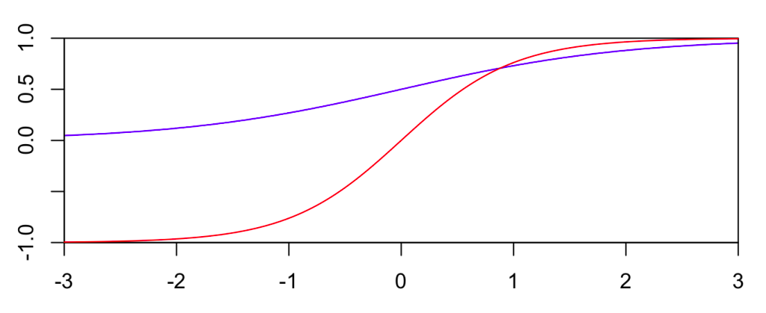
SIGMOID Fn
Tanh- tanh is a rescaled logistic sigmoid function. The tanh function, a.k.a. hyperbolic function, is a rescaling of the logistic sigmoid, such that its outputs range from -1 to 1. (There’s horizontal stretching as well.)
tanh(x)=2g(2x)−1
Blue is the logistic function, and red is tanh.
ReLU - ReLU stands for rectified linear unit, and is a type of activation function. Mathematically, it is defined as y = max(0, x).
ReLU is the most commonly used activation function in neural networks, especially in CNNs.
If we are unsure what activation
function to use in your network,
ReLU is usually a good first choice

Slide 21
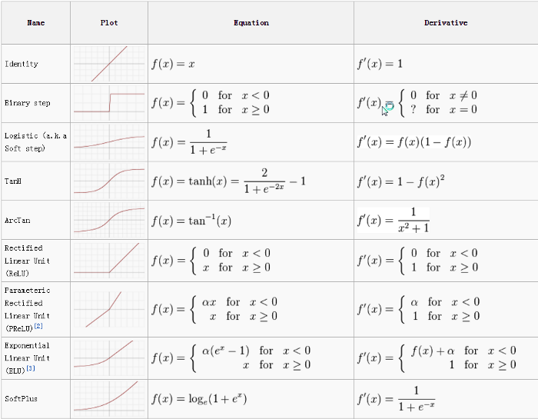
All Fn

Slide 22
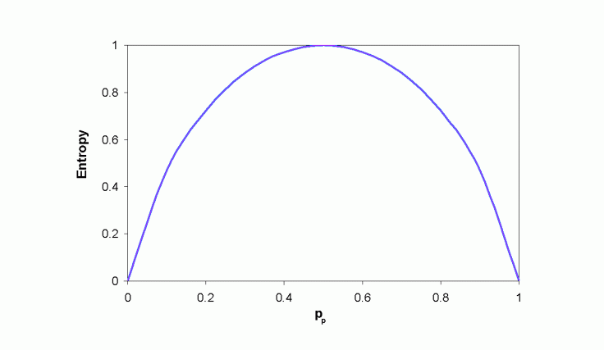
Entropy
Entropy is a measure of randomness.
Its a measure of unpredictability.
Example of a coin toss.
Suppose we tossed a coin 4 times, and the output of the events came as {Head, Tail, Tail, Head}.
Entropy = -(probability(a) * log(probability(a))) – (probability(b) * log(probability(b)))

Slide 23
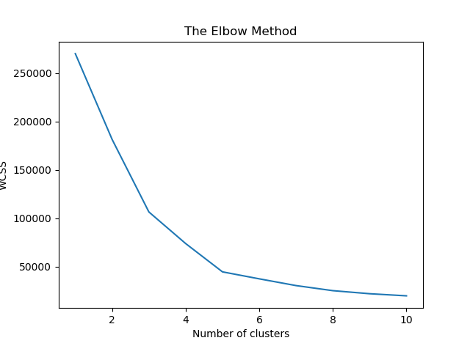
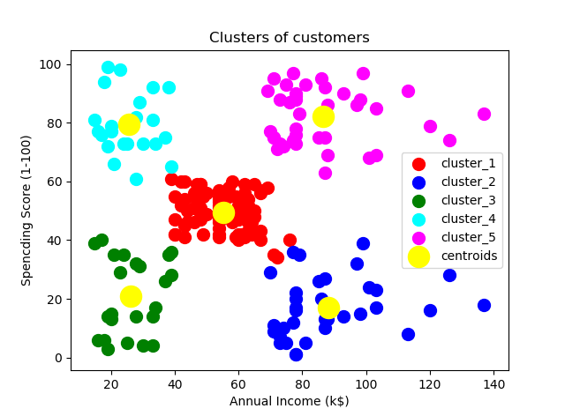
Clusters size
The Elbow method is a method of interpretation and validation of consistency within cluster analysis designed to help finding the appropriate number of clusters in a dataset.

Slide 24
Fast Fourier Transform
FFT is computed on a time domain signal to check its behavior in the frequency domain.
FFT finds its application in disciplines such as signal and noise processing, image processing, audio signal processing, etc.
SciPy implement the fftpack module, which lets the user compute fast Fourier transforms.
The Fourier transform decomposes a function of time (a signal) into the frequencies that make it up, in a way similar to how a musical chord can be expressed as the frequencies (or pitches) of its constituent notes.
Data whitening is a process of reducing the data to white noise vector. It decorrelates the individual components of a random vector and makes the variance 1.

Slide 25
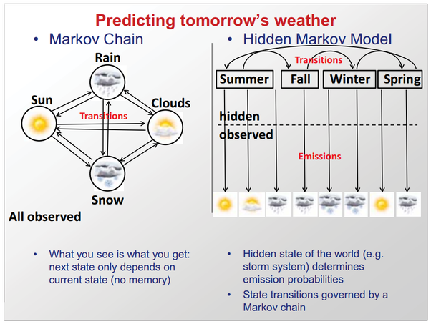
Hidden Markov Model
HMM, is to predict the sequence of state changes, based on the sequence of observations.
HMM is one of the most used algorithms in speech recognition systems.

Slide 26
Saving to CSV
Saving to predicted value into csv .
numpy arrays don't have a to_csv function, use pandas
import numpy as np
import pandas as pd
prediction = pd.DataFrame(predictions, columns=['predictions']).to_csv('prediction.csv')
use the numpy.savetxt function while saving:
numpy.savetxt('C:/localpath/test.csv',prediction, ,delimiter=',')
while loading a CSV file can use numpy.genfromtxt function:
numpy.genfromtxt('C:/localpath/test.csv', delimiter=',')

Slide 27
Hardware Learning
Graphics processing unit
Tensor processing unit
Vision processing unit

Slide 28
Sample
asd

Slide 29


THANKS

